Slide 1
TIME SERIES ANALYSIS
By, Ganesh Jadhav
Kiran Akadas

Slide 2
CONTENTS
What do you think Q-A series
Introduction to timeseries
Timeseries Components
Timeseries Forecasting
Stationarizing the data

Slide 3

What do you think?
What SELLS the MOST in rainy season?

Slide 4
What do you think?
What month mango sells the most?
Why do you think TRP of sports channels go so high during summers in India?
What can you tell me the nature of bill about coming months?

Slide 5
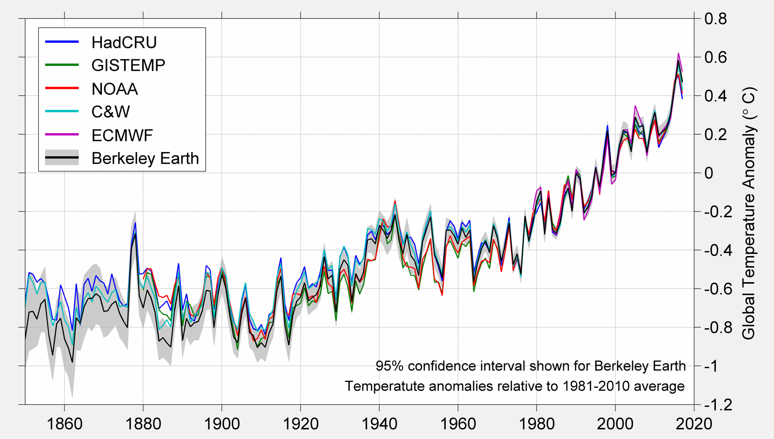
TIME SERIES
What is time series?
What is time series analysis?
Where else do you think time series analysis plays a role?

Slide 6
JUST SOME BASICS
TIMESERIES COMPONENTS-
Trend
Seasonal
Cyclic
Irregular

Slide 7
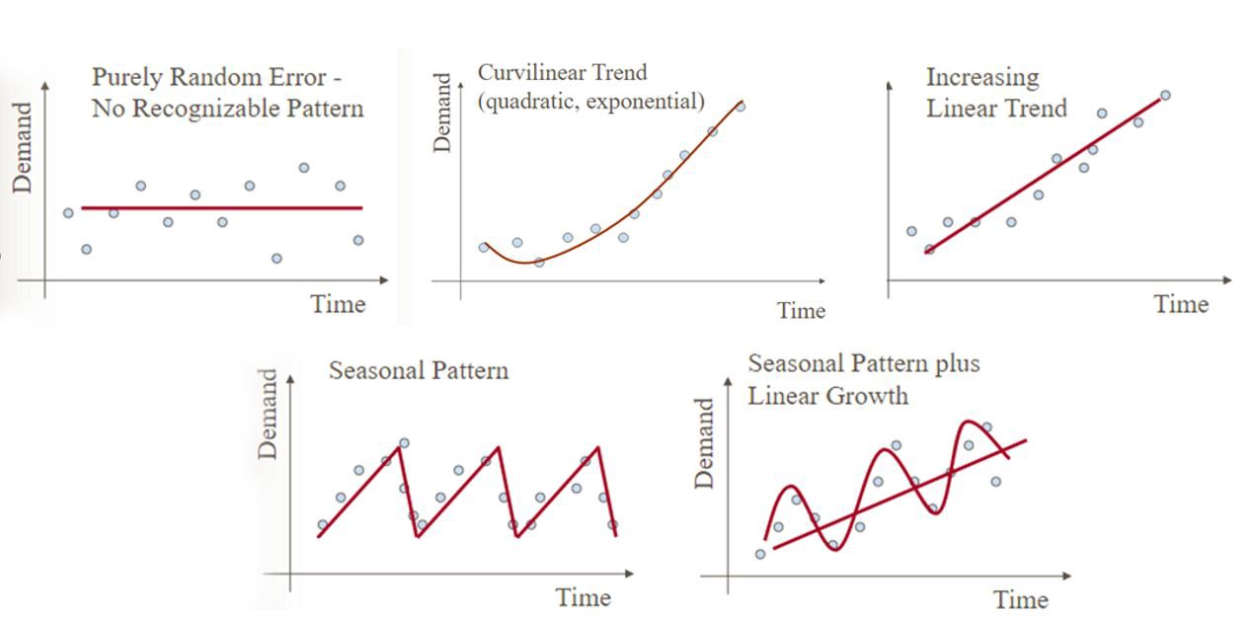
TREND COMPONENT
Long term direction of a timeseries data.

Slide 8
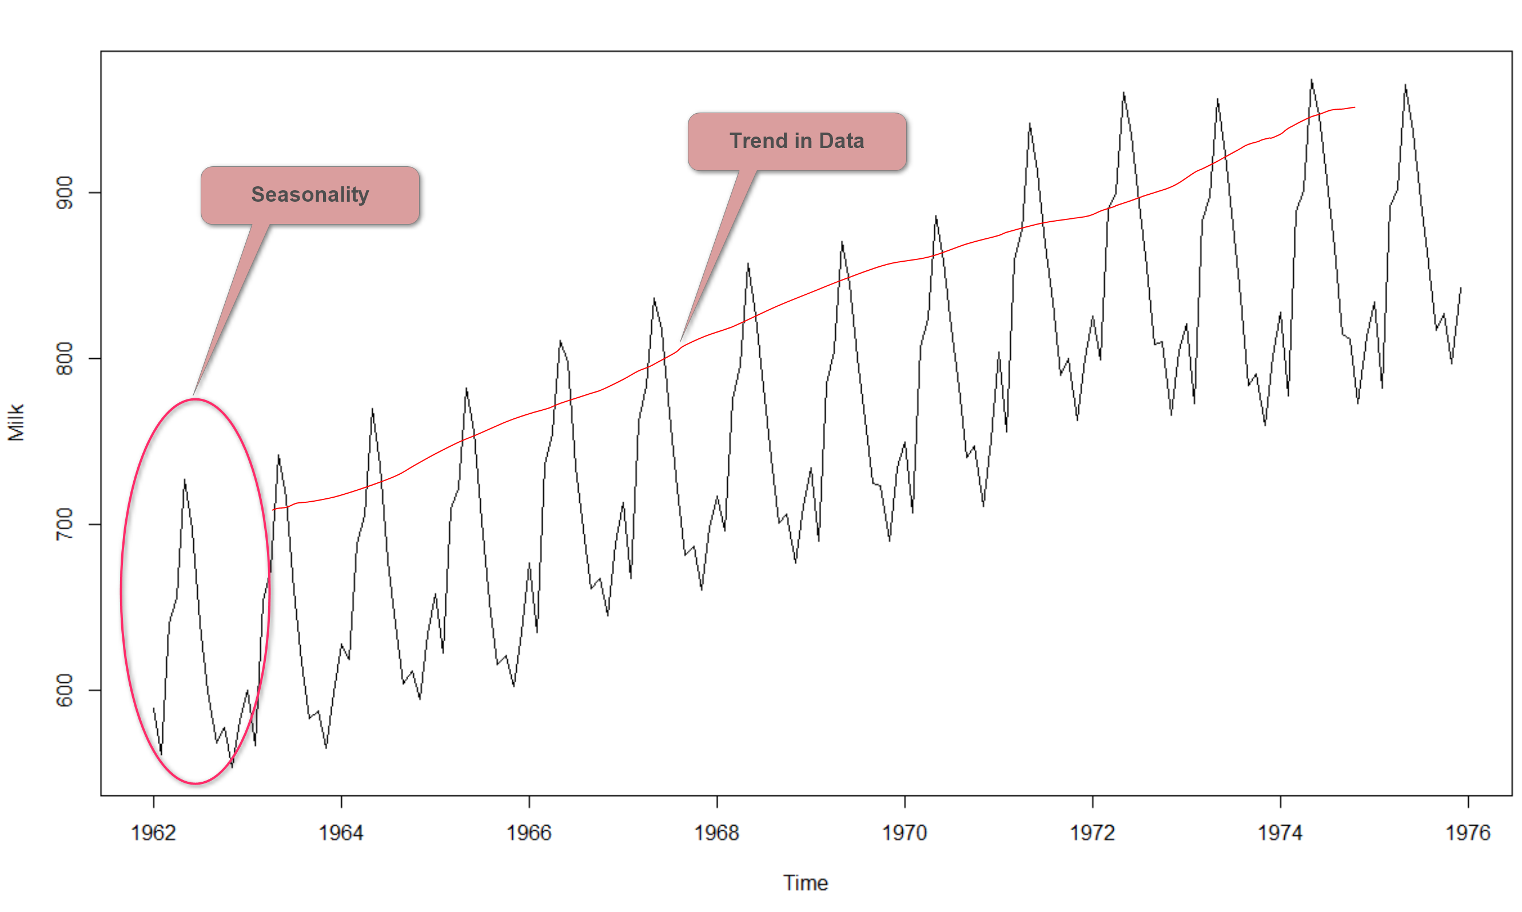
SEASONAL COMPONENT
Regular patterns of variations with certain time periods, such as year or month.

Slide 9
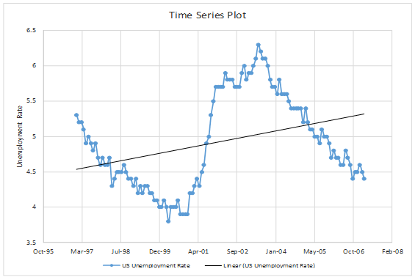
CYCLIC COMPONENT
Any regular pattern of sequences of values above or below trend line lasting for more than a year.

Slide 10
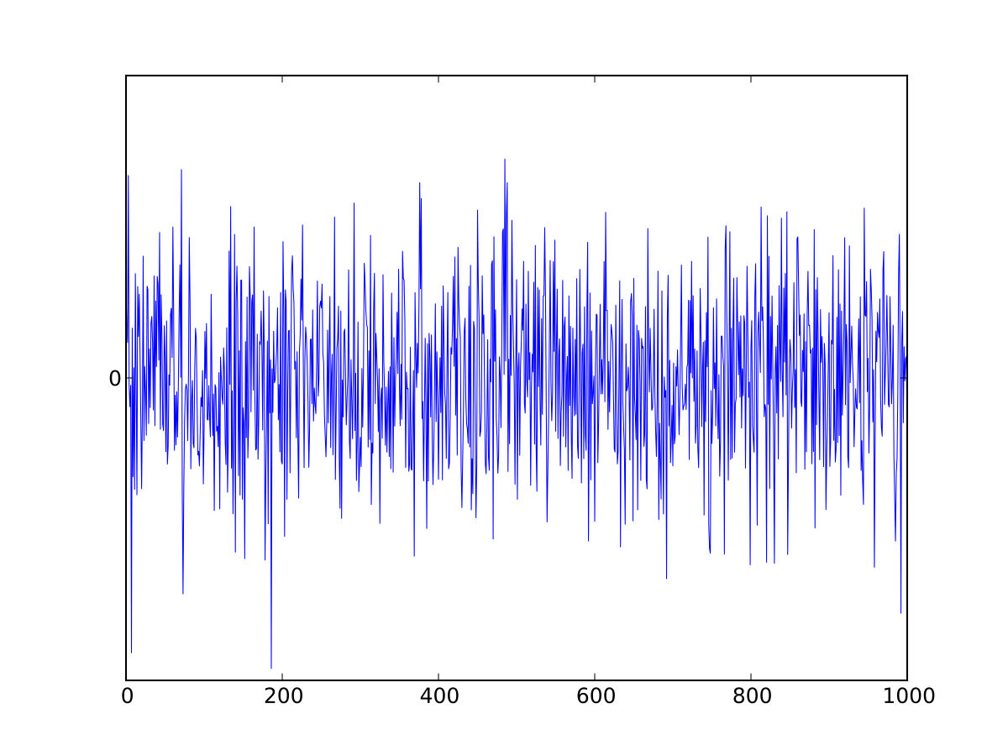
IRREGULAR COMPONENT
Variations in the timeseries data that maybe due to erratic and irregular actions that might have caused.

Slide 11
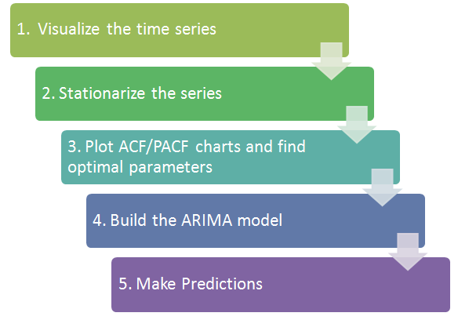
TIME SERIES FORECASTING

Slide 12
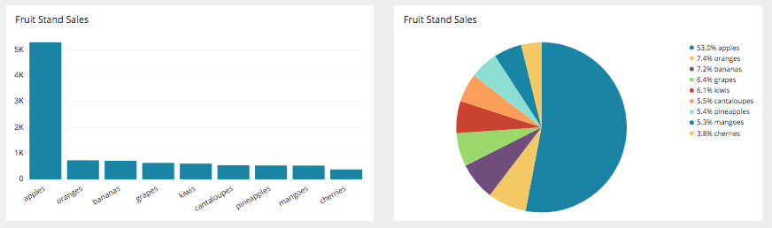
VISUALISING THE DATA
Line graph will suit the most to show the trend.
In-built commands in pandas for plotting: dataframe.plot()
Bar and Pie chart may also be used.

Slide 13
STATIONARITY OF THE DATA
Points that will be covering in this section-
What do you mean by stationary series
Why do we have to have stationarity in the data
Ways of checking the stationarity of the data
Ways of stationarizing the data

Slide 14
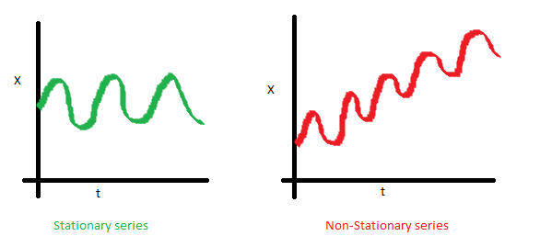
STATIONARY SERIES
There are three basic criterion for a series to be classified as stationary series :
The mean of the series should not be a function of time rather should be a constant

Slide 15
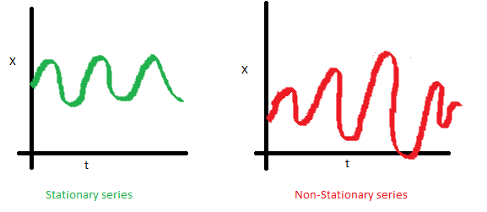
STATIONARY SERIES
2. The variance of the series should not a be a function of time.
This property is known as homoscedasticity.

Slide 16
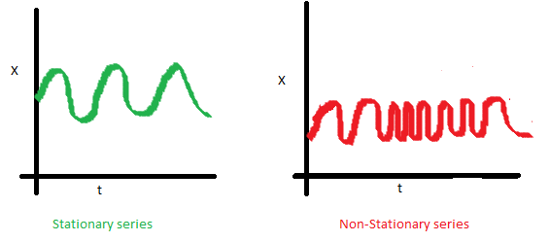
STATIONARY SERIES
3. The covariance of the i th term and the (i + m) th term should not be a function of time.

Slide 17
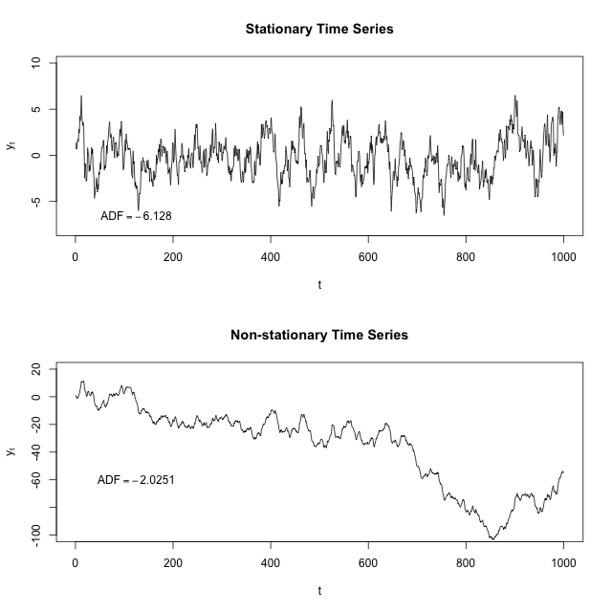
NEED FOR STATIONARITY IN THE SERIES
Why is it necessary to make the series stationary?

Slide 18
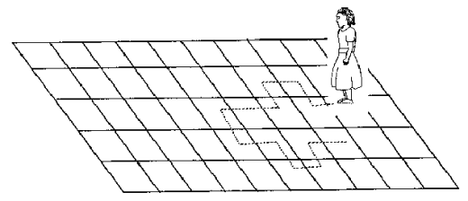
NEED FOR STATIONARITY IN THE SERIES
Why is it necessary to make the series stationary?

Slide 19
WAYS TO CHECK FOR STATIONARITY
Look at Plots: plot a run sequence plot to see anything with an obvious trend or seasonal effects
Summary Statistics: partition your data into intervals and check for obvious or significant differences in summary statistics
Statistical Test: use statistical tests if the expectations of stationarity are met or violated

Slide 20
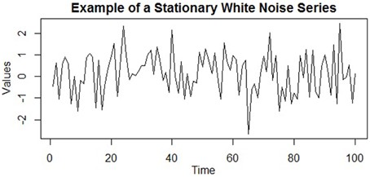
WAYS TO CHECK FOR STATIONARITY(LOOKS,PLOTS)
Stationary Time Series:
Data does not have any upward or downward trend or seasonal effects.
Mean or variance are consistent over time

Slide 21
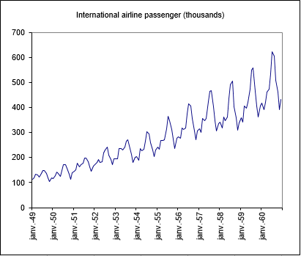
WAYS TO CHECK FOR STATIONARITY(LOOKS,PLOTS)
Non-Stationary Time Series:
data show trends, seasonal effects, and other structures depend on time.
Forecasting performance is dependent on the time of observation.
Mean and variance change over time and a drift in the model is captured.

Slide 22
WAYS TO CHECK FOR STATIONARITY(LOOKS,PLOTS)
ROLLING STATISTICS: Plot moving average or moving standard deviation to see if it varies with time.
Kwiatkowski-Phillips-Schmidt-Shin (KPSS) test

Slide 23
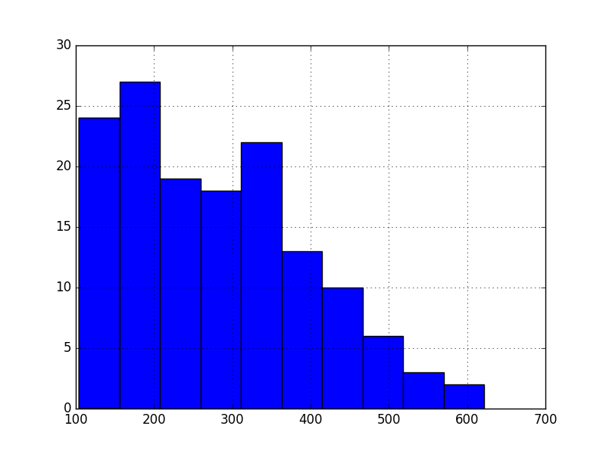
WAYS TO CHECK FOR STATIONARITY(STATS)
Summary Statistics
A quick and dirty check to see if your time series is non-stationary is to review summary statistics.
You can split your time series into two (or more) partitions and compare the mean and variance of each group. If they differ and the difference is statistically significant, the time series is likely non-stationary.

Slide 24
WAYS TO CHECK FOR STATIONARITY(STATS)
Augmented Dickey-Fuller test (ADF):
ADF tests the null hypothesis that a unit root is present in time series sample. ADF statistic is a negative number and more negative it is the stronger the rejection of the hypothesis that there is a unit root.
Null Hypothesis (H0): If accepted, it suggests the time series has a unit root, meaning it is non-stationary. It has some time dependent structure.
Alternate Hypothesis (H1): The null hypothesis is rejected; it suggests the time series does not have a unit root, meaning it is stationary.
p-value > 0.05: Accept H0, the data has a unit root and is non-stationary
p-value ≤ 0.05: Reject H0. the data does not have a unit root and is stationary

Slide 25
WAYS TO STATIONARIZE THE DATA
Three commonly used technique to make a time series
stationary:
Detrending
Differencing
Transformation

Slide 26
WAYS TO STATIONARIZE THE DATA: DETRENDING
MOVING AVERAGE METHOD-
The term MOVING is used because it is obtained by summing and averaging the values from a given no of periods, each time deleting the oldest value and adding a new value.
Steps-
Select the period.
Take average for the selected period.
For ex:- 3-yearly moving averages can be calculated from the data : a, b, c, d, e, f can be computed as :
(a+b+c)/3, (b+c+d)/3, (c+d+e)/3, (d+e+f)/3

Slide 27
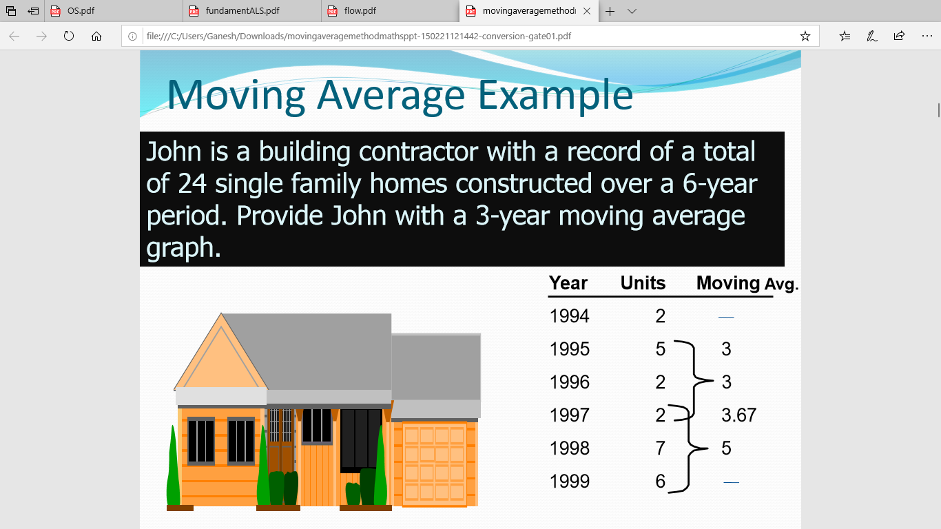
WAYS TO STATIONARIZE THE DATA: DETRENDING

Slide 28
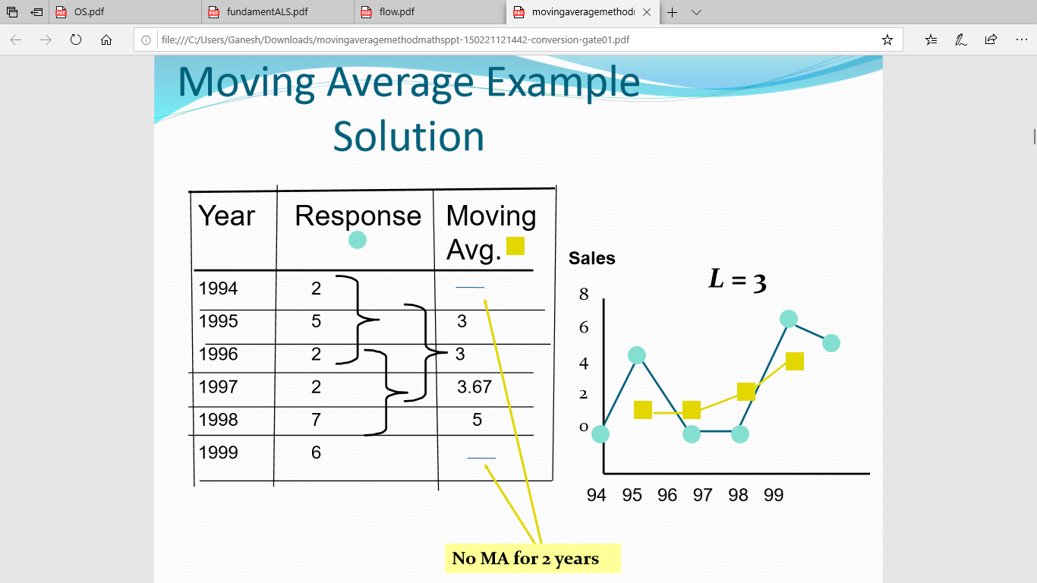
WAYS TO STATIONARIZE THE DATA: DETRENDING

Slide 29
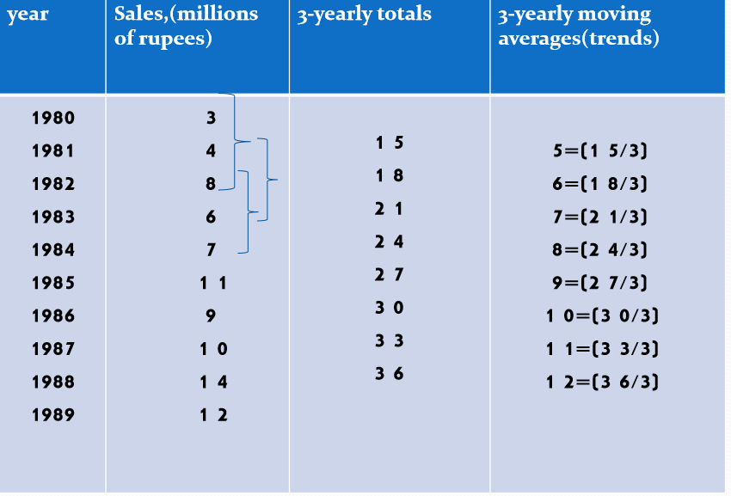
WAYS TO STATIONARIZE THE DATA: DETRENDING

Slide 30
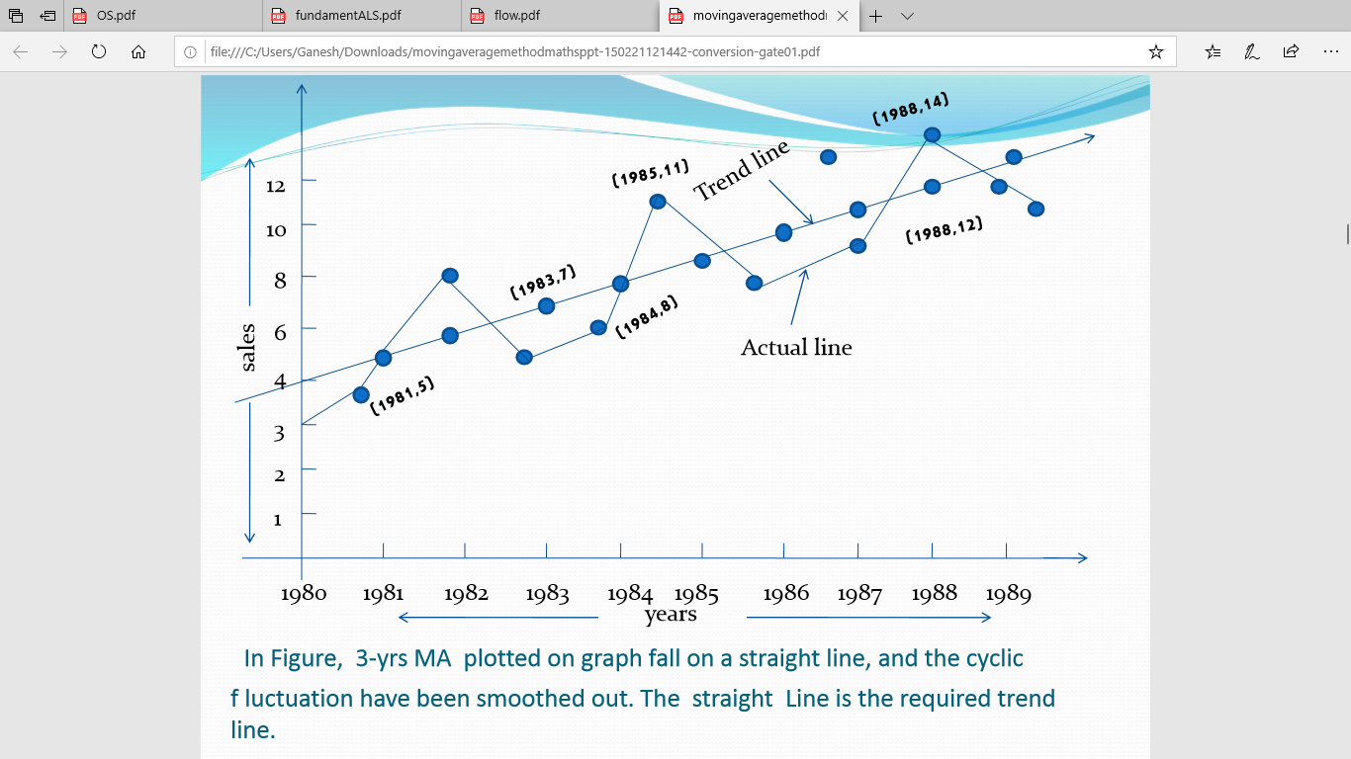
WAYS TO STATIONARIZE THE DATA: DETRENDING

Slide 31
WAYS TO STATIONARIZE THE DATA: DIFFERENCING
First Order Differencing : This is the difference between the current time period and the previous time period.
Second Order Differencing: If these values fail to revolve around a constant mean and variance in F.O.D. then we find the second differencing using the values of the first differencing.
We repeat this until we get a stationary series

Slide 32
WAYS TO STATIONARIZE THE DATA: TRANSFORMATION
1. Log Transform
Involves taking the log of each observation.
You can use base-10 logs .
The back transformation is to take the exponential the number.
2. Square-root transformation
This consists of taking the square root of each observation.
The back transformation is to square the number.
If you have negative numbers, you can't take the square root; you should add a constant to each number to make them all positive.
3. Other transforms - Arcsine transformation etc.

Slide 33
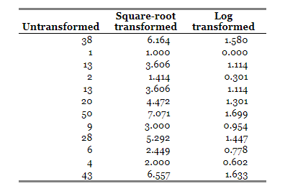
WAYS TO STATIONARIZE THE DATA: TRANSFORMATION
More on transforms- http://www.biostathandbook.com/transformation.html

Slide 34
WAYS TO STATIONARIZE THE DATA: TRANSFORMATION
When and how to chose the type of transformation?
Chose Square root transformation if the data is count.
example- bacterial colonies per petri dish, blood cells going through a capillary per minute, mutations per generation, etc.
Chose Log transform when the data is size mainly
Example- when u find the height of tree after 10 years, the final size of a tree would be a function of nitrogen×water×sunlight×insects, and mathematically, this kind of function turns out to be log-normal.

Slide 35
ACF
ACF is an (complete) auto-correlation function which gives us values of auto-correlation of any series with its lagged values.
In simple terms, it describes how well the present value of the series is related with its past values.
A time series can have components like trend, seasonality, cyclic and residual.
ACF considers all these components while finding correlations hence it’s a ‘complete auto-correlation plot’.

Slide 36
PACF
PACF is a partial autocorrelation function
Basically instead of finding correlations of present with lags like ACF, it finds correlation of the residuals with the next lag value hence ‘partial’ and not ‘complete’ as we remove already found variations before we find the next correlation.

Slide 37
MODEL BUILDING
MOST USED TIME SERIES MODELS
Moving Average Model (MA)
Autoregressive Model (AR)
Autoregressive integrated moving average model.( ARIMA)
Seasonal ARIMA (SARIMA)

Slide 38
MORE ON AR, MA
Why do you think we don’t use regression for timeseries analysis?
What are the differences between regression and timeseries data?

